Slide 1
Unit 4
A field is a region of space in which an object experiences a force.

Slide 2
What kinds of fields are there?
A Gravitational field is a region of space in which a mass will experience a force.
A Magnetic field is a region of space in which a magnetic pole will experience a force.
An Electric field is a region in which a charge particle/object experiences a force.

Slide 3
Fields
Closer the lines the stronger the field.
The stronger the field the bigger the force that acts.
Field lines have direction

Slide 4
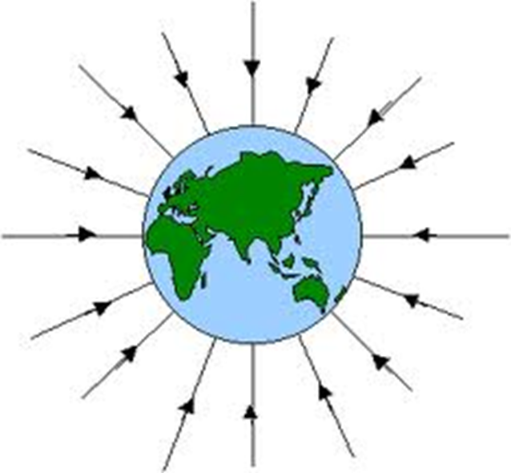
Gravitational Field
Direction - force on a mass

Slide 5
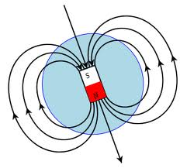
Magnetic field
Direction – force on a North pole

Slide 6
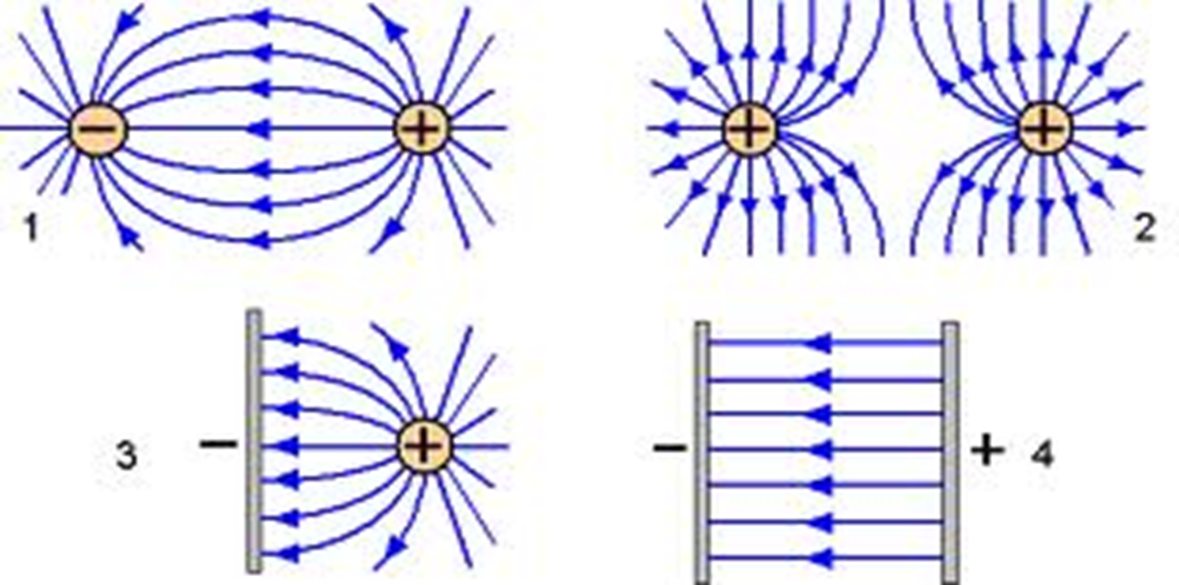
Electric field
Direction – force on a positively charged particle.

Slide 7
Magnetic Fields
Chapter 7

Slide 8
Magnetic Fields
A magnetic field is a region of space which causes a magnetic pole to experience a force.
Maxwell’s equations for FIXED fields mean…
An electric field can exert a force on a charged particle.
A magnetic field can exert a force on a charged particle if it is moving.

Slide 10
Field lines (magnetic flux, Φ, measured in Weber) show the direction in which a North pole is pushed. (Shown by an arrow)
The strength of a magnetic field is called the magnetic flux density, B, measured in Tesla.
The closer the field lines the stronger the field is.
(Page 60)

Slide 11
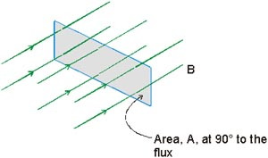
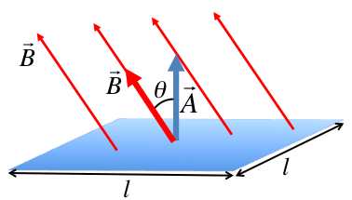
Magnetic Flux
Magnetic flux φ is measured in Weber.
Φ = BA when area is at a right angle to the flux.
Φ = B sin ϑ x A when area is at angle ϑ to the flux.

Slide 12
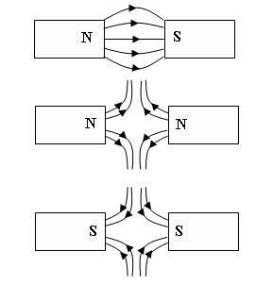
Magnetic fields between poles

Slide 13
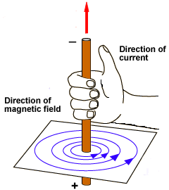
Field around a wire

Slide 14
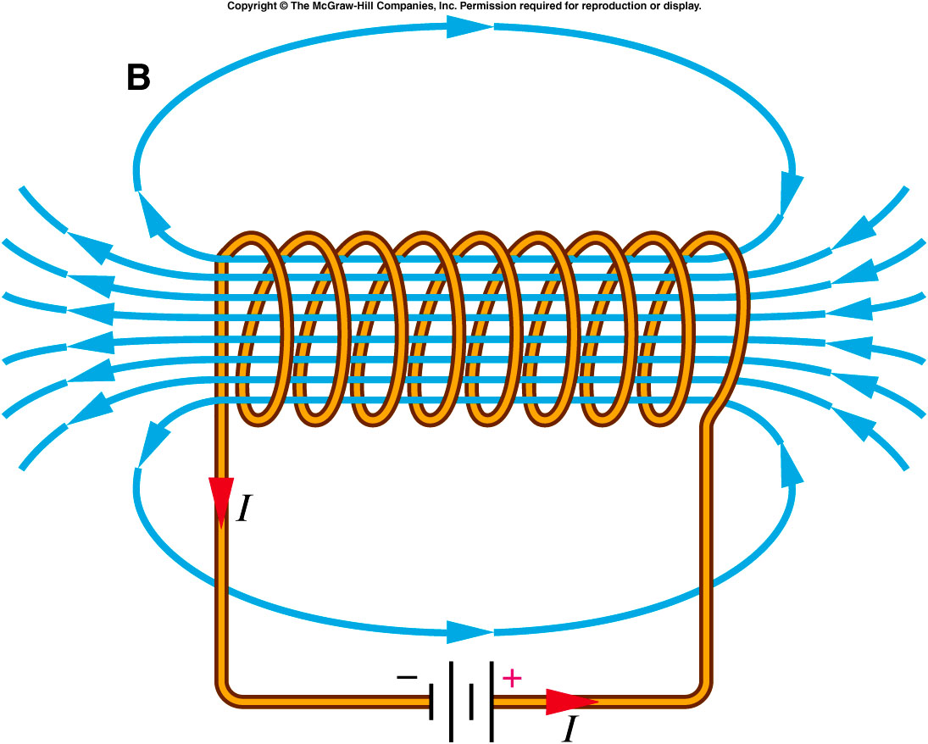
Magnetic field lines around a solenoid
Background reading: http://onlinephys.com/magnetism.html

Slide 15
Force on a current in a magnetic field
(Interaction between two fields)
(page 54)

Slide 17
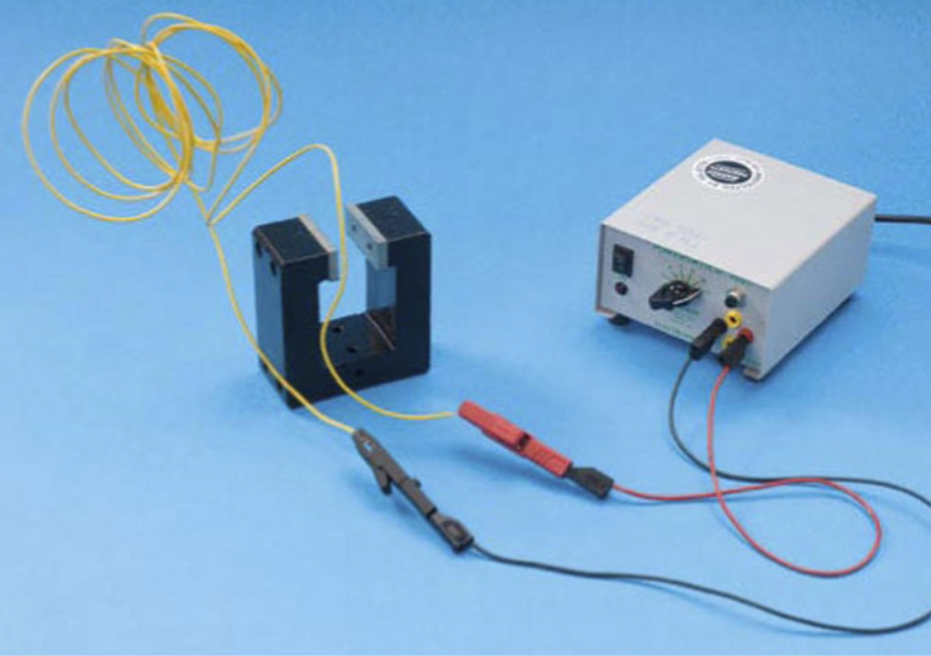
Force on a current in a magnetic field
When a wire carrying a current is placed in a magnetic field the wire experiences a force.

Slide 18
Fleming’s Left Hand Rule
Magnetic Fields can affect moving charges – this is called the Motor Effect.
Background reading:
http://www.schoolphysics.co.uk/age16-19/Electricity%20and%20magnetism/Electromagnetism/text/Force_on_a_current_in_a_magnetic_field/index.html

Slide 19
:
Background reading: http://www.s-cool.co.uk/a-level/physics/forces-in-magnetic-fields/revise-it/the-motor-effect-and-flemings-left-hand-rule

Slide 20
In which direction will the wire move?

Slide 21
Experiment: To measure the force on a current-carrying conductor (page 55)

Slide 22
F = BIL sin ϑ
The size of the force depends on……
The size of the magnetic field
The size of the current
The length of wire in the field
The angle between the direction of current and field. (Max when 90⁰)
^{(See worked example on p 56)}

Slide 23
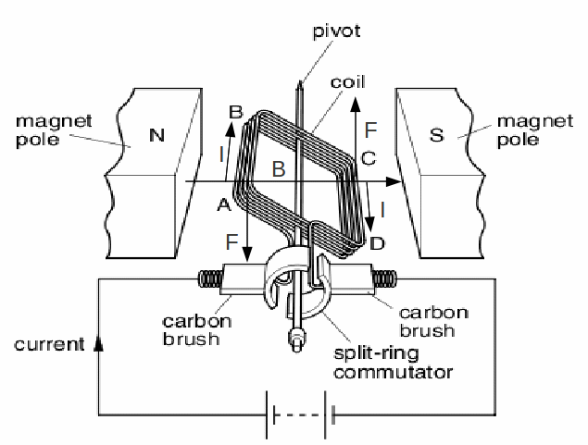
Electric Motors

Slide 24
F = BIL
The motor can be made to run faster by
Increasing the current, I
Increasing the number of turns of wire
Increasing the size of the magnetic field

Slide 25
Force on a moving charge in a magnetic field
A charged particle has a charge Q and moves at a speed v.
In time interval t, each particle travels a distance vt.
This is equivalent to current I =Q/t along a wire of length l = vt
If the particle passes through a uniform magnetic field in a direction at right angles to the field lines, the particle will experience a force F due to the field.
vt
Q
Force on a moving charge

Slide 26
If the velocity of motion of a charged particle in a magnetic field is at angle θ to the lines of the field. Then…….
If the velocity of the charged particle is perpendicular to the direction of the magnetic field (θ = 90 = sin 90 =1) so the equation becomes :
If the velocity of the charged particle is parallel to the direction of the magnetic field (θ = 0 = sin 0 =0) so F = 0

Slide 27
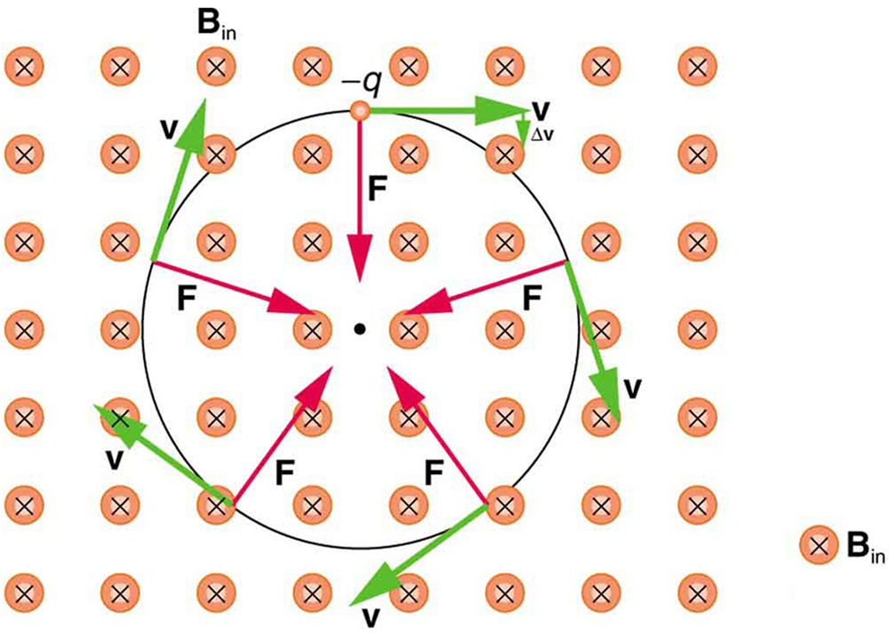
Electron Beams
Use the left hand rule to get the direction
Remember LHR applies to conventional current (positive charge)

Slide 28
Charged particles in circular orbits
Magnetic field s are used to control beams of charged particles in devices such as television tubes and high energy accelerators
The force causes a centripetal acceleration (directed towards the centre of the circle) because it is perpendicular to the velocity. The path is a complete circle because the magnetic field is uniform and the particle remains in the field.
The radius r of the circular orbit depends on the speed of the particles and the magnetic flux density B.
Re-arranging this for r shows that as r decreases the path is more curved.
.

Slide 29
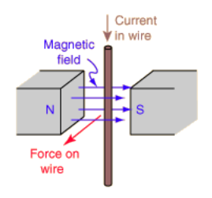
Electromagnetic Induction (page 61)
When the magnet is moved near the wire, a small current passes through the meter, this is because an emf is induced in the wire.
If the wire is part of a complete circuit, the induced emf forced electrons round the circuit.
The emf can be increased by:
moving the wire faster
Using a stronger magnet
Making the wire into a coil.

Slide 30
Faraday’s Law (page 61)
The induced emf in a circuit is equal in size to the rate of change of magnetic flux linkage through the circuit.

Slide 31
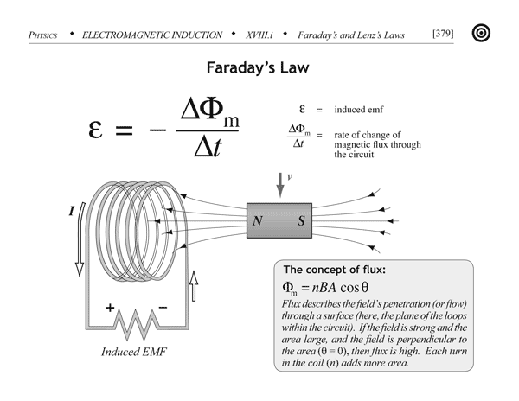

Slide 32
Lenz’s Law
Lenz’s Law states that the direction of the induced current is always such as to oppose the change that causes the current.
This law is a consequence of energy conservation, if the induced current were in a direction to help the change that caused it, energy would be produced from nowhere.......which is forbidden!

Slide 33
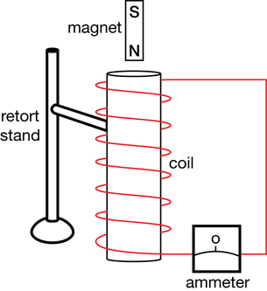
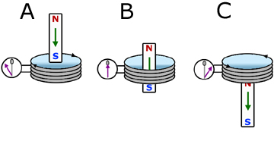
Dropping a magnet through a coil

Slide 34
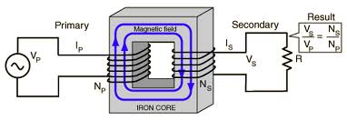
Transformers
http://www.s-cool.co.uk/a-level/physics/transformers-and-rectification/revise-it/transformers-and-the-turns-rule

