Slide 1
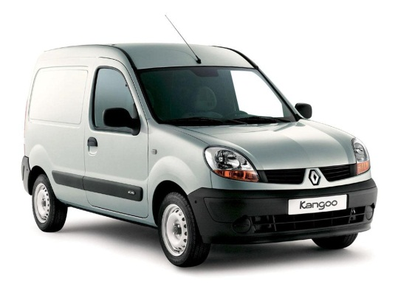
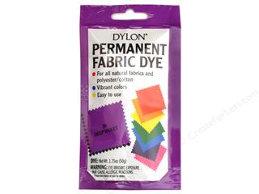
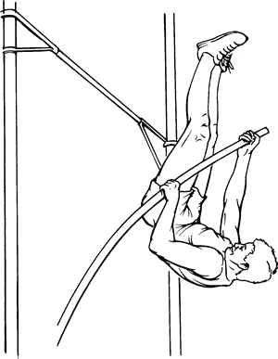
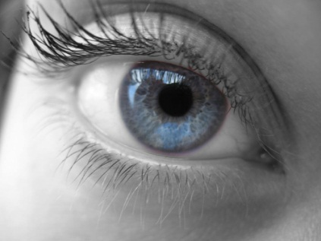
Keyword Dingbats (not elements)
1
2
3
s

Slide 2
Learning Outcomes
Describe hydrogen bonding between molecules containing –OH and –NH groups.
Describe and explain the anomalous properties of water resulting from hydrogen bonding.

Slide 3
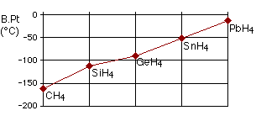
The boiling point of compounds of hydrogen and group 4 elements. Why does it increase?

Slide 4
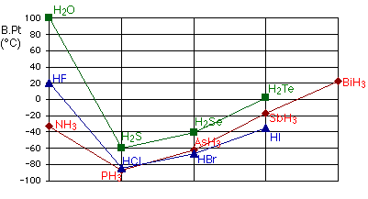
Boiling point of compounds of hydrogen and group 5,6 and 7 elements. What is unusual?

Slide 5
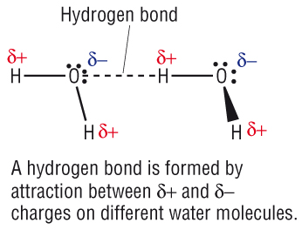
Occurs in O-H and N-H bonds ( and H-F)

Slide 6
Why do hydrogen bonds only form between O-H and N-H (and F-H)?
It might help to sketch the shape and dipoles of the molecules containing these atoms (such as H₂O)

Slide 7
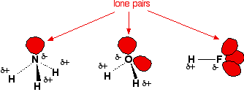

Slide 8
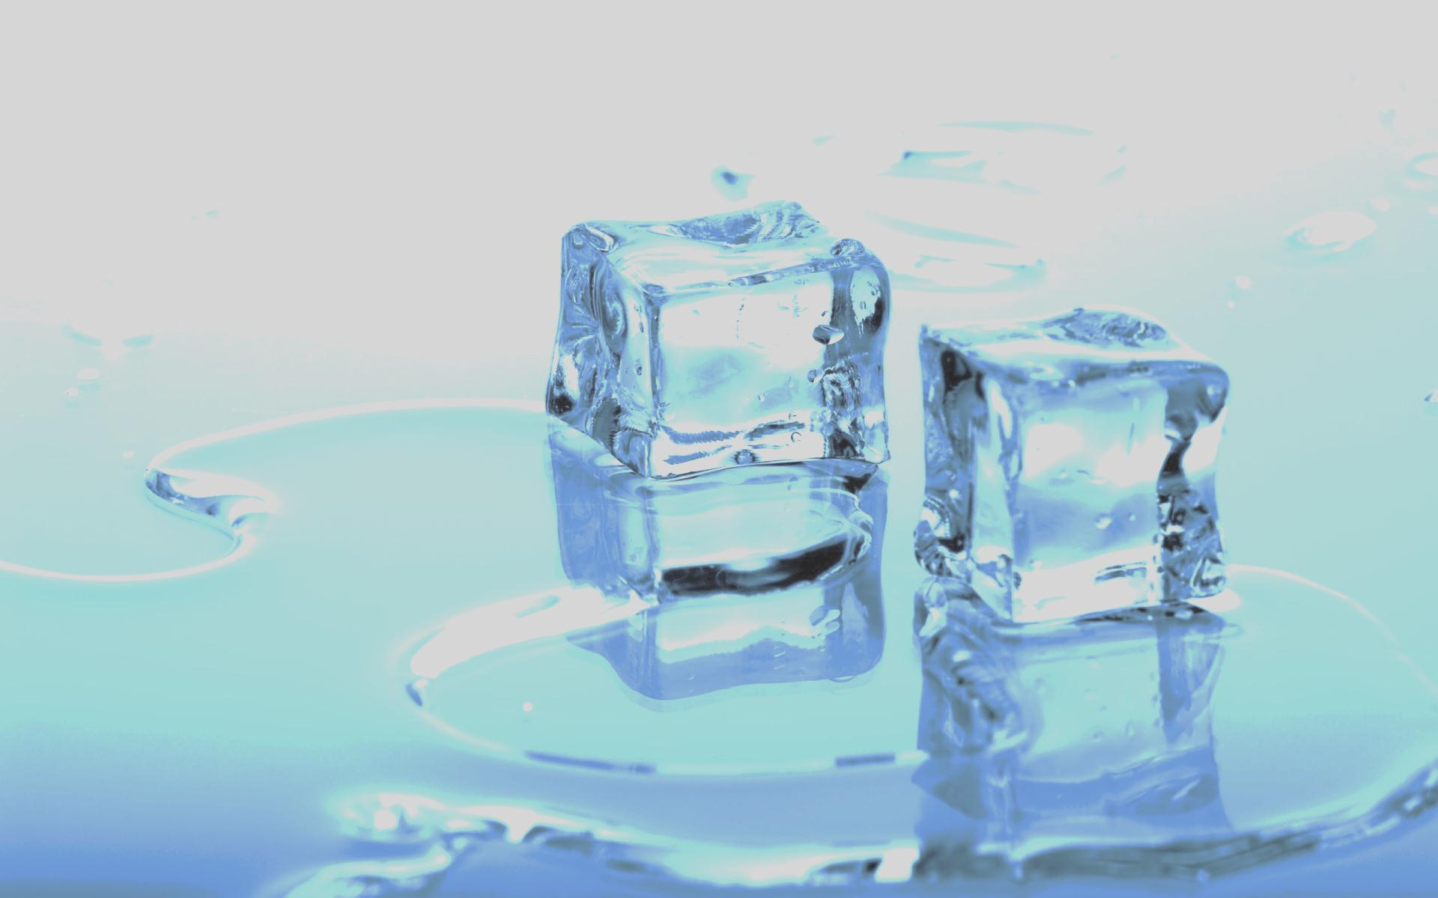
Hydrogen Bonds
What happens to the volume of water when it freezes?
How does this differ from other liquids?
What causes this?

Slide 9
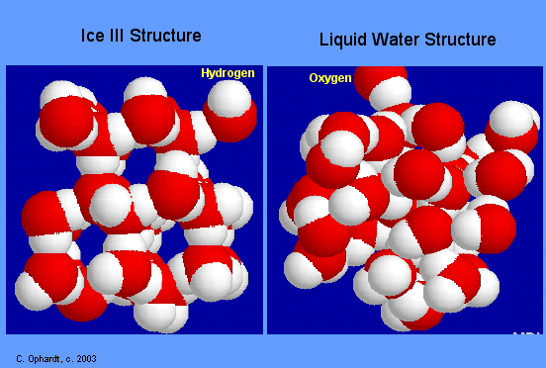
Ice has open lattice, H-bonds hold water molecules apart.
When ice melts, H₂O molecules move closer together.

Slide 10
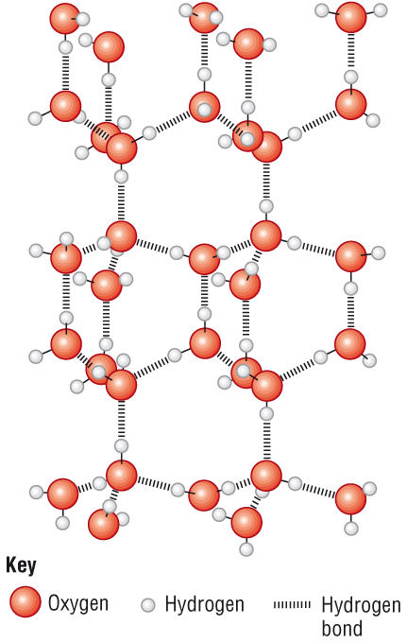

Slide 11
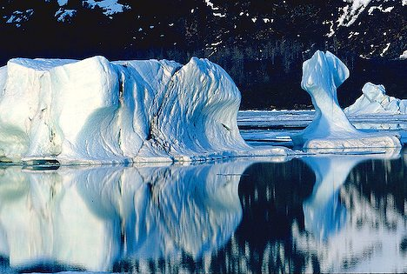

Slide 12
How much does volume increase?
Comparison of:
Liquid water | Ice
Mass = 100 g | Mass = 100 g
Volume = 100 mL | Volume = ? mL
Density = 1.0 g/mL | Density = 0.92 g/mL
1) Calculate the volume in a 100 g ice cube with a density of 0.92 g per mL.
2) What is the exact change in volume of the water when it freezes as ice?

Slide 13
Many simple molecular structures are gases at room temperature but H₂O is a liquid – why?

Slide 14
Other molecules are held together by van der Waals, but water molecules are held together by hydrogen bonds which are stronger and harder to overcome.

Slide 15
Bond type | Relative strength
Ionic and covalent bonds | 1000
Hydrogen bonds | 50
Dipole-dipole forces | 10
Van der Waals’ forces | 1

Slide 16
Other
H-bonds also give water relatively high surface tension and viscosity.
H-bonds are important in organic compounds containing O-H and N-H bonds (alcohols, carboxylic acids etc)
They are responsible for shape of proteins and even DNA.

Slide 17
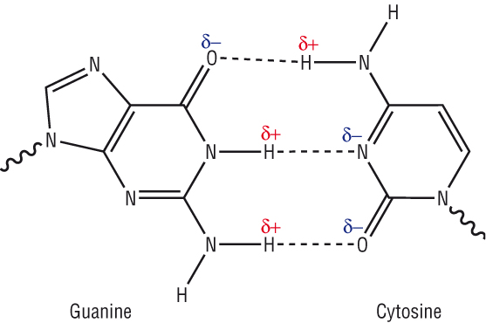
DNA

Slide 18
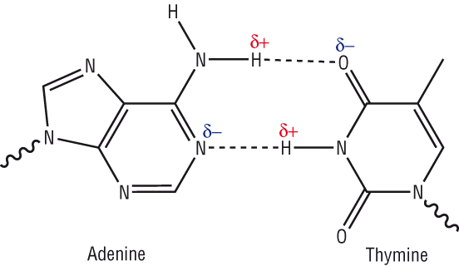
DNA

Slide 19
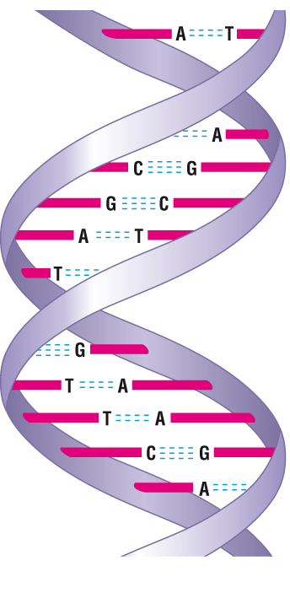
DNA Double Helix

Slide 20
Key Point
Remember when ice melts or boils, hydrogen bonds break – but the covalent bonds do not.

Slide 21
Questions
Which of the following molecules have hydrogen bonding?
H₂S b) CH₄ c) CH₃OH d) PH₃ e) NO₂ f) CH₃NH₂
2) Draw diagrams showing H-bonds between:
2 molecules of water
2 molecules of ammonia
2 molecules of ethanol
1 molecule of water and 1 molecules of ethanol

Slide 22
Homework
Create a poster summarising bonding and structure.
OR
Create a revision guide for module 2 for another Chemistry student.

