Slide 1
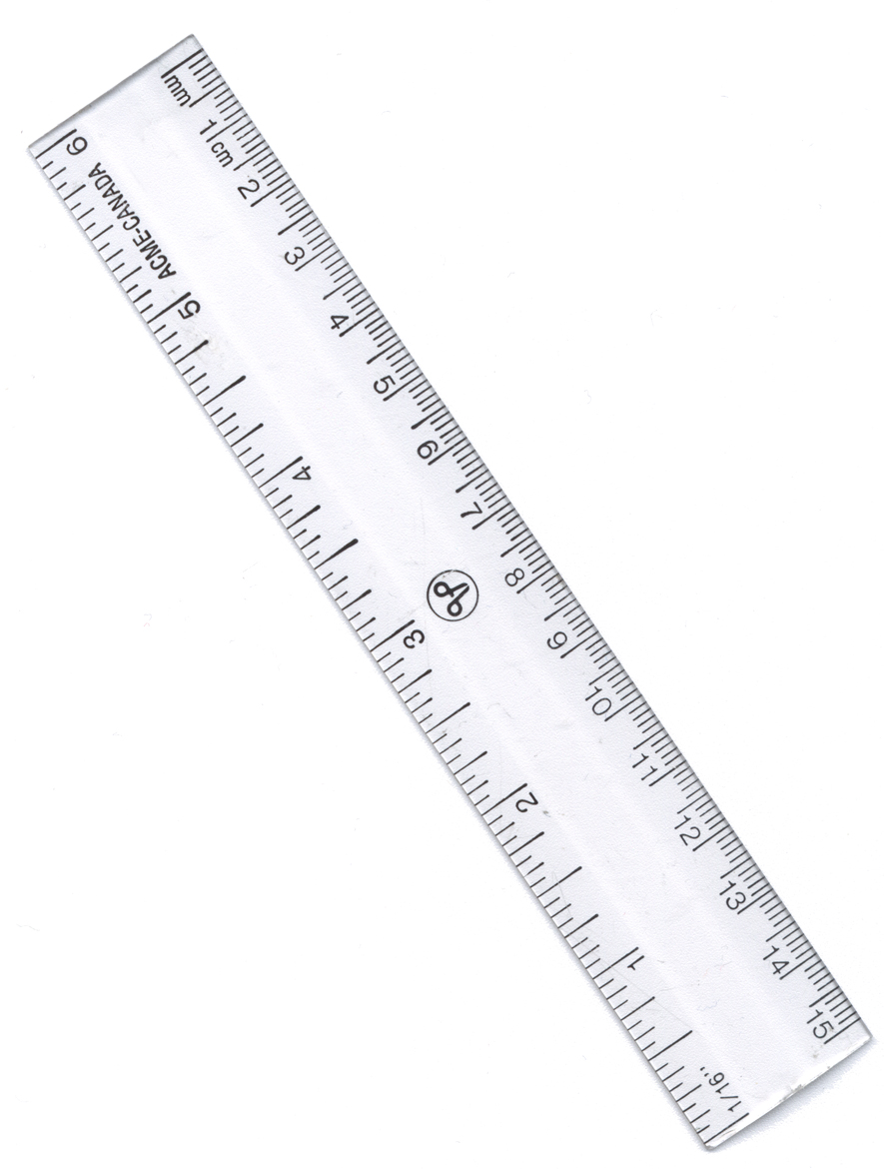
Drawing A Line Graph
Use a sharp pencil and a ruler
Draw two axis and label with the variables (independent on x axis, dependent on y axis)
Write the scales on each axis
Add the units to the axis label
Plot data on the graph with small crosses (With repeated results draw the averages and range bars)
Draw a line of best fit if applicable (Thinks about if it should go through 0,0)
Add a title and underline it
You might want to start your title ‘A graph to show....’
On the vertical line (y axis) put the dependent variable. This is what you measured to find out the effect.
Top tip: A line of best fit does not mean joining the dots. Draw a straight or curved line that ‘best fits’ the data
Top tip: Look at your results to determine an appropriate scale. Don’t go up to 100 if your highest result is 12!
On the horizontal line (x axis) put the independent variable. This is the thing you changed to find out its effect.

