Slide 1
Starter
On whiteboards…
Write down four examples of scalar quantities and four examples of vector quantities.
Scalars;
Length, area, volume
Speed
Mass
Density
Pressure
Temperature
Energy, work, power
Entropy
Vectors;
Velocity
Momentum
Acceleration
Force (lift, drag, thrust, weight etc.)
Displacement

Slide 2
Naming forces
All forces can be written as ‘the push/pull of………on……….’. Rewrite these;
Weight
Friction
Air Resistance
Lift
Thrust
Reaction
Tension

Slide 3
Rules for Free Body Diagrams
A free body diagram separates an object from its situation and focusses only on the forces acting ON THE OBJECT. This means we can make predictions about its behaviour.
e.g. draw a free body diagram of a book on a table.
1. Sketch the object you are focussing on and nothing else.

Slide 4
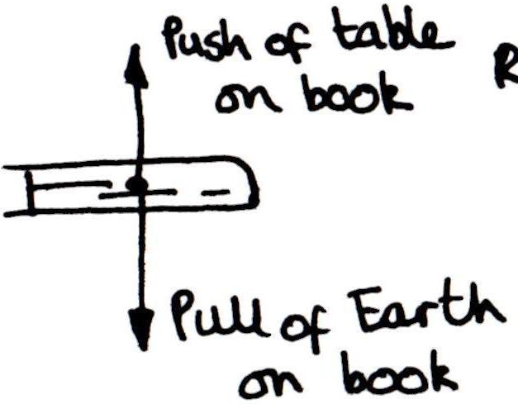
Rules for Free Body Diagrams
2. Make sure you only draw forces acting from the centre of the object (its centre of gravity)
3. Draw on the forces that are acting on the object.

Slide 5
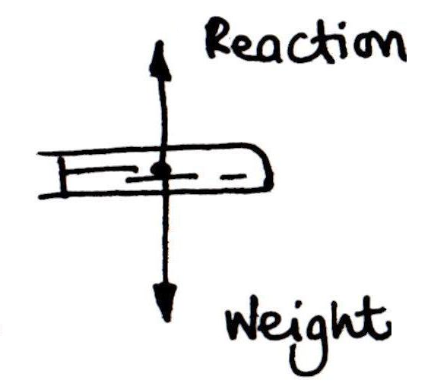
Rules for Free Body Diagrams
3. Label the forces

Slide 6
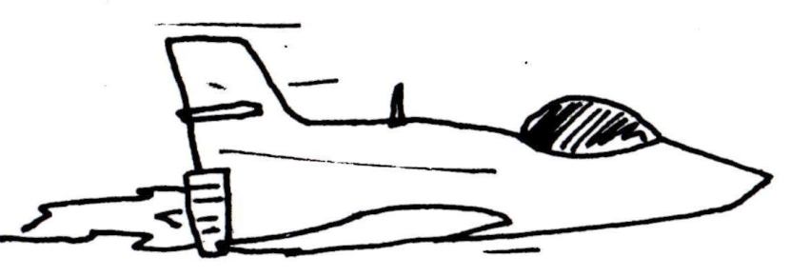
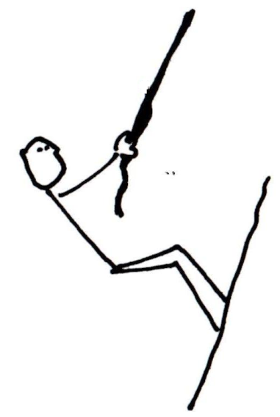
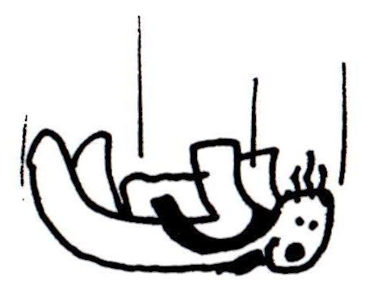
Free Body Diagrams Try it for these situations…
1.
3.
4.
2.

Slide 7
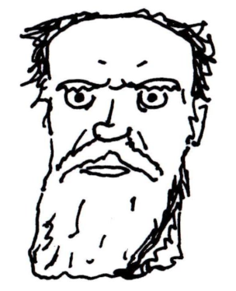
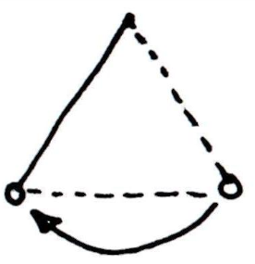
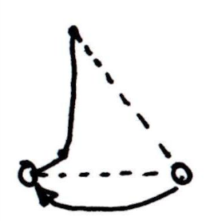
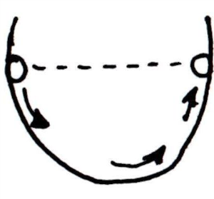
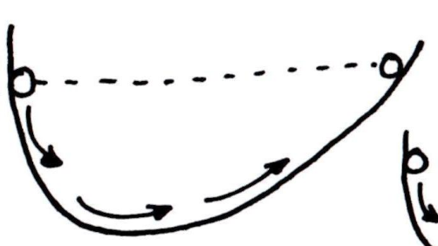
Galileo’s ideas
He was unimpressed with Aristotles ‘obvious’ explanation of motion and decided to think for himself.
Whatever happened the bob returned to the same height.

Slide 9
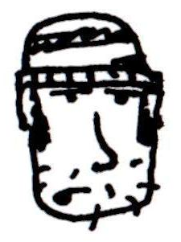
Newton’s First Law
Objects at rest OR constant velocity stay at rest OR constant velocity unless acted upon by an external force.
So, basically, if it’s stopped it’s gonna stay stopped unless you push it. If it’s travelling at a steady speed it’s gonna carry on unless you push it. Easy.
If ΣF on the object = 0 then Δv = 0. Nice.

