Slide 1
AS Physics Case Study? This sounds suspiciously like English to me…
A step-by-step guide

Slide 2
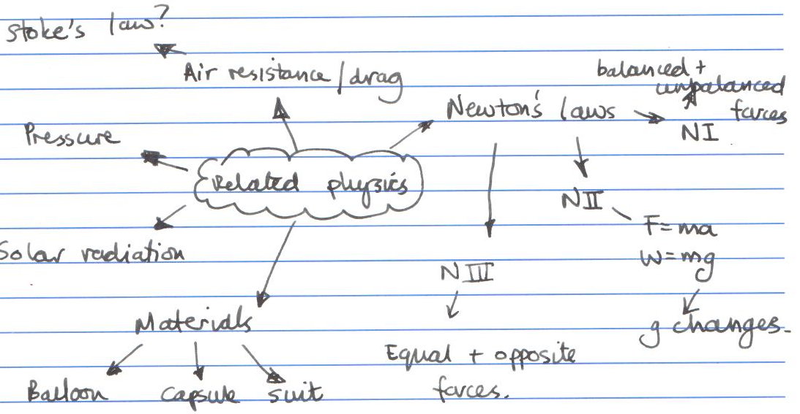
Step 1 – Brain Storm (AKA Thought Shower *shudder*)
Read through the briefing notes and jot down ideas on the physics related to the topic…

Slide 3
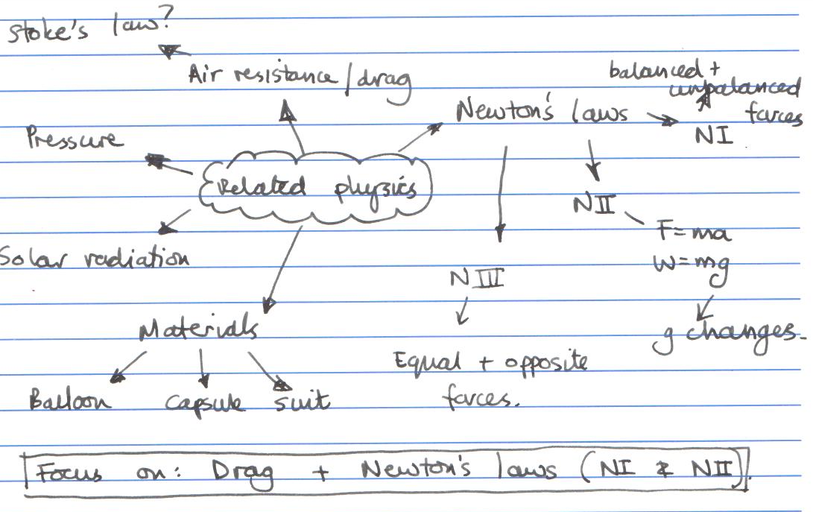
Step 2 – Decide which two main physics ideas you are going to focus on
It makes it easier if they are based on ideas you have already studied…

Slide 4
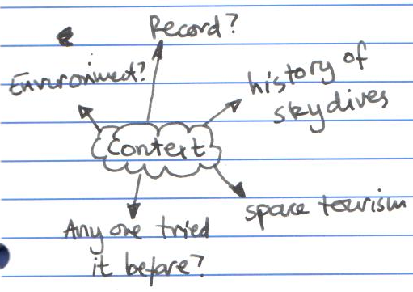
Step 3 – Think about context
You could focus on the history of this piece of physics or the environmental impact.

Slide 5
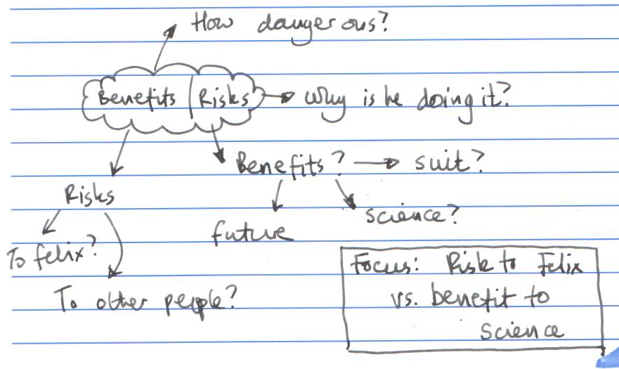
Step 4 – Think about benefits and risks
Compare the two and balance them up. Is it worth it?

Slide 6
Step 5 – Write your introduction
Doing it now will help to focus you during your research
‘On the 14th of October 2012 Felix Baumgartner became the first sky diver to break the speed of sound after he reached a velocity of 373 ms⁻¹ . This case study will focus on the forces acting on Mr. Baumgartner as he fell and apply Newton’s laws to his motion. There will also be a discussion about the environmental impact of the mission and the benefits versus risks.’

Slide 7
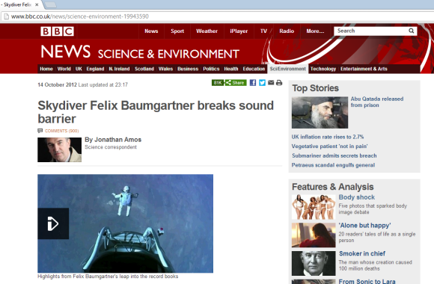
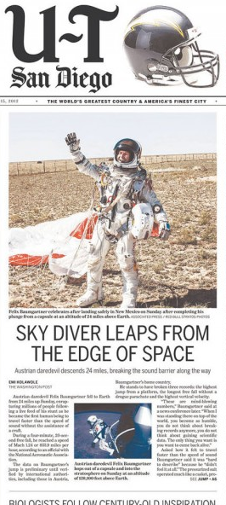
Step 6 – Find your sources
Make sure that they are different types of source.
e.g.
Website
Newspaper
Textbook
Popular Science book
Journal
Magazine

Slide 8
Step 7 – Write it!
Don’t forget to;
Use physics key words properly (don’t use ‘gravity’ when you mean ‘weight’ etc.)
Include one piece of graphical data that you haven’t already been given.
Do what you say you’ll do in the introduction.
Link to the practical.
Keep it around 500 words long.
Write the bibliography

Slide 9
Step 8 – The bibliography
Books;
Author, Date, Title, Page, Publisher, Where published
Newspapers/magazines;
Author of article, Date, Title of article and publication, Publisher, Where published
Websites;
Full web address, date accessed.

