Slide 1
Secondary data/information

Slide 2
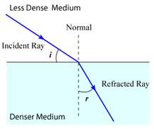
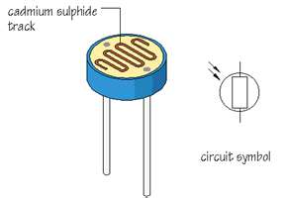
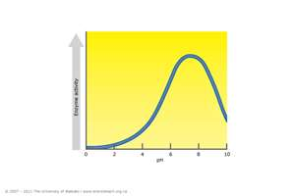
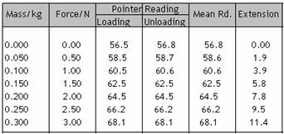
Secondary data can be: science explanations, diagrams, tables of results, graphs
Fundamentals of waves
Seeing, hearing, feeling warmth, surfing, tuning the radio, using a cellphone – these and many more activities involve waves.
But what is a wave? In this article, we get to grips with the different kinds of waves and look at the key characteristics of all waves – their wavelength, period, frequency, speed and amplitude. These concepts are important for describing waves of all kinds.

Slide 3
Places you can find secondary data:
Internet
Textbook
Pupils in your group doing the same/different experiments
Calculating predicted results from formulae
Given by the exam board

Slide 4
If you are trying to find tables of results or graphs..
What is my independent variable?
What is my dependent variable?

Slide 5
Only use sources that you understand.

Slide 6
Make a numbered bibliography listing all your sources.
References
[1] Geiver L. and Jessen Holly. International Ethanol Report: 2010. http://www.ethanolproducer.com/articles/6696/international-ethanol-report-2010. 2010.
[2] OCR. Factors that affect the rate of fermentation. Information for candidates [1]. 2011.
[3] Skow Kate, Microbewiki. Soil environment and physical factors controlling microbial activity. http://microbewiki.kenyon.edu/index.php/Soil_environment_and_physical_factors_controlling_microbial_activity. 2011.
[4] Spilatro S.R. Yeast on the Rise: Investigative Study of Fermentation in the Introductory Biology Curriculum. http://www.cur.org/rl2000/pdf/ystferm.pdf[

Slide 7
Comparing primary and secondary data
Primary data = results you have collected yourself
Secondary data = information you have researched
(Hint: It can be easier to compare sources if they are both graphs – sometimes you may want to plot a graph from the secondary data)

Slide 8
Check……
What are the similarities/differences?
Do they cover the same range?
Are they measure in the same units?
How many different measurements are there?
Are there any repeats?
Do they have the same trends?
Do they give the same conclusion?
(Are there any other detailed differences/similarities?) e.g gradients, (0,0)

