Slide 1
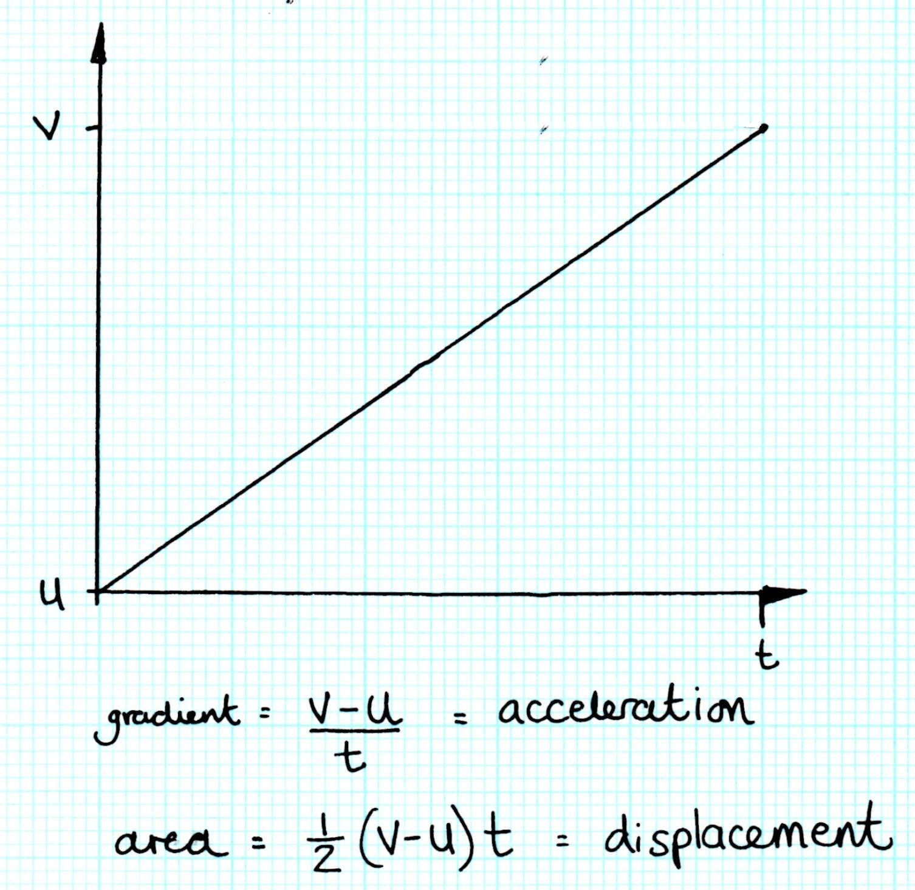
And now for some hard core physics…

Slide 2
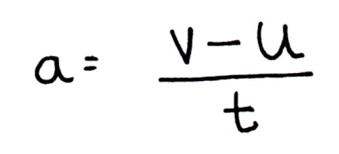
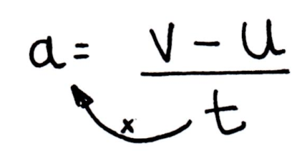
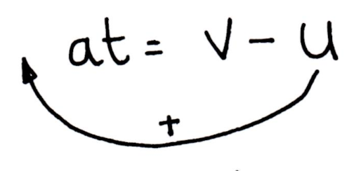
And now for the equations of motion…
Well, actually you already know one! Rearrange this to make v the subject;
Answer:

Slide 3
Things to do with v = u + at
The Hulk is dropped off the flying fortress. He falls for 30 seconds before hitting the ground. How fast does he hit the ground?
The USS Enterprise is coasting in space at 20,000 ms⁻¹ and fires its engines so that it accelerates at 20ms⁻² . How long will it have to keep accelerating until it reaches a speed of 300,000ms⁻¹ ?
The bat mobile passes a police speed trap at 30ms⁻¹. At another speed trap 10 seconds later it was caught doing 60ms⁻¹. What was the average acceleration?

Slide 4
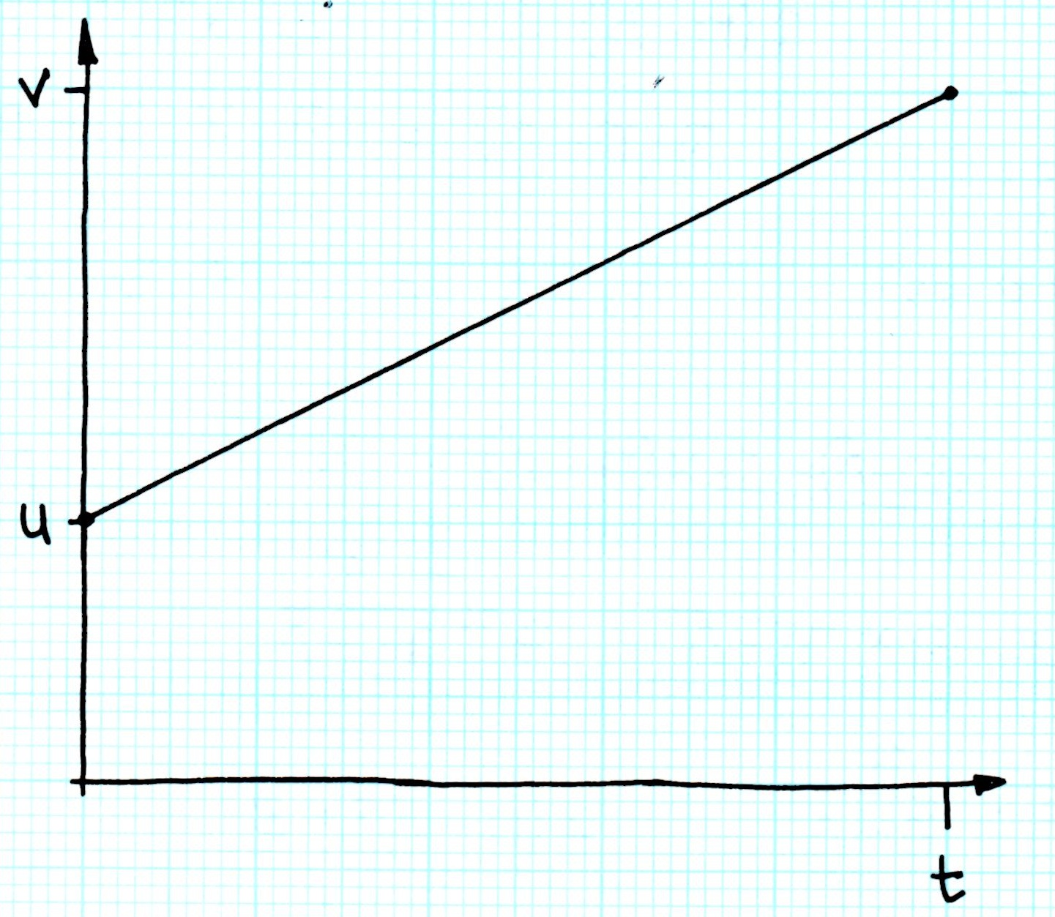
And now for the equations of motion…
1. Give an expression (using only symbols) for the area under the graph.

Slide 5
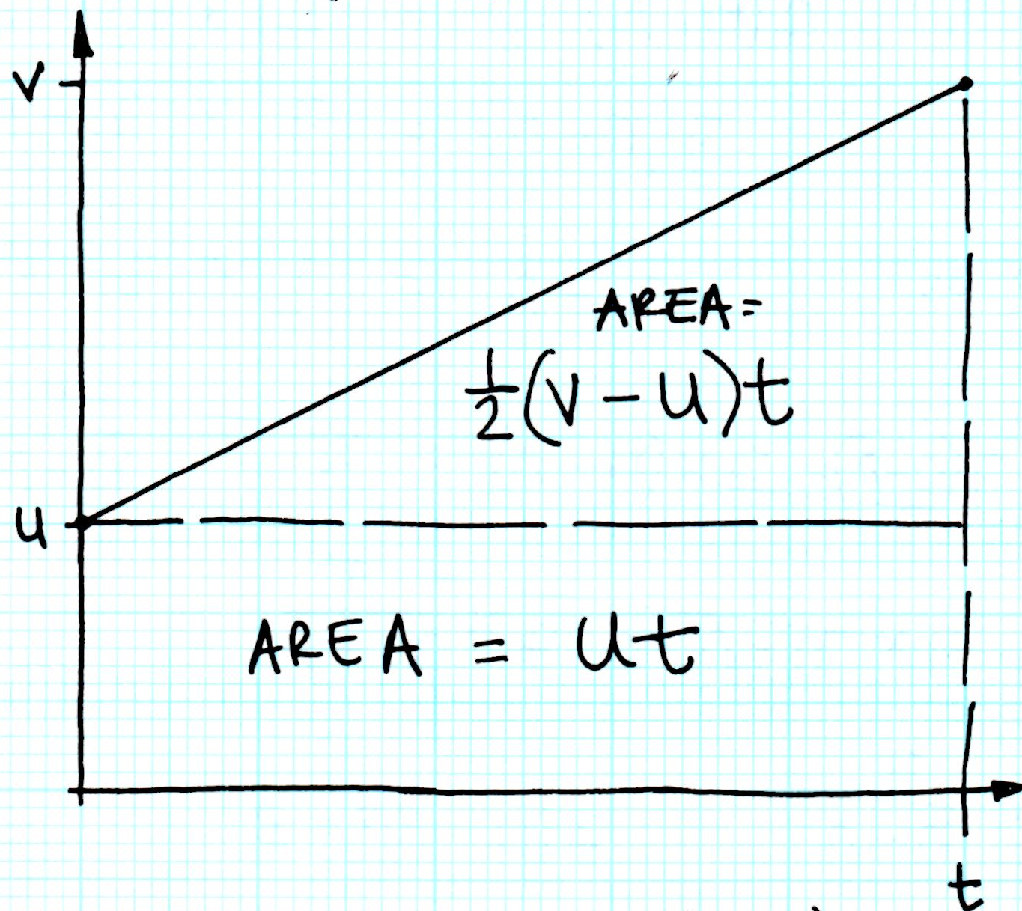
And now for the equations of motion…
2. Use the first equation of motion to help you replace (v-u) with something else.

Slide 6
And now for the equations of motion…

Slide 7
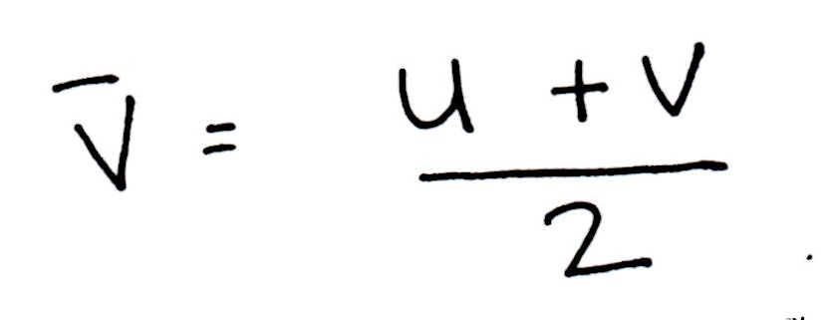
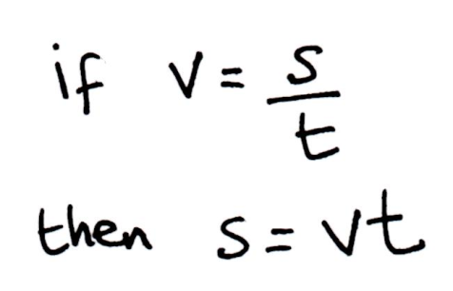
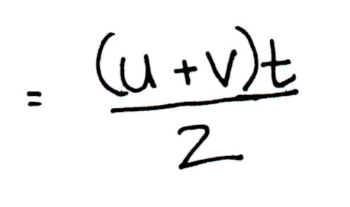
And now for the equations of motion…

Slide 8
And now for the equations of motion…

Slide 9
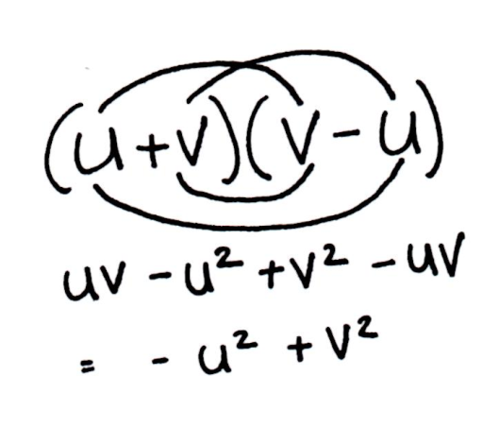
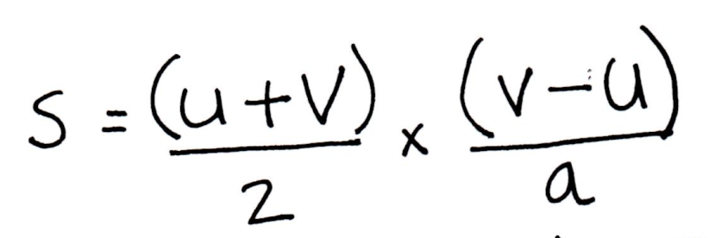
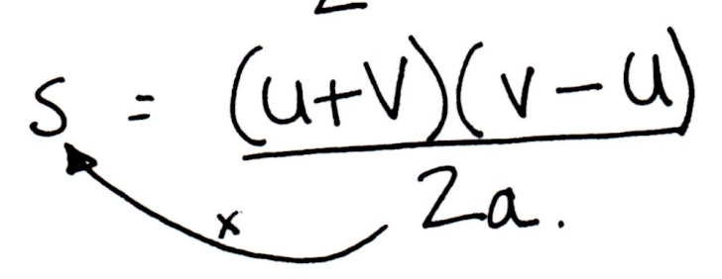
And now for the equations of motion…

Slide 10
The equations of motion
Memorise these! It will make life so much easier.

