Slide 1
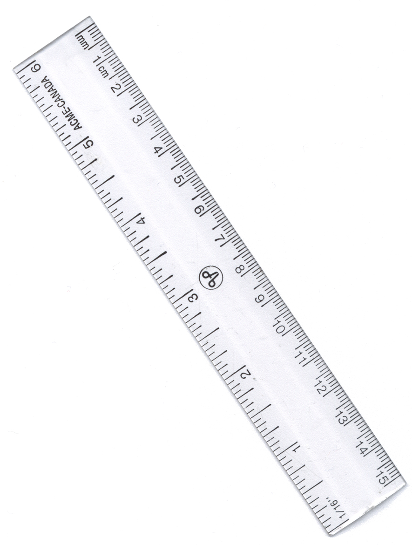
Drawing A Table of Results
Use a sharp pencil and a ruler
Draw two columns (if you repeated your results draw enough columns to show the repeats and average)
Write the variable at the top of each column.
Add the units each column heading.
Put the results in the table. (Use the same number of decimal places for results in each column)
6. Calculate the averages.
7. Add a title to say what is in your results table.
Add a title to your table.
The first column is usually your independent variable.
Table 1: To show the extension measured when different masses were added to a spring.
Mass (g) | 1. Extension of spring (cm) | 2. Extension of spring (cm) | 3. Extension of spring (cm) | Average extension of spring (cm)
Top tip:
Check each column heading includes the units.
Top tip: Show your repeated results
Remember to include a column for the averaged results (mean).
Outliers:
If one of your results seems wrong do not cross it out but do go back and check it and show this.

